Slide 1

Cloud Computing
SATHYABAMA
INSTITUTE OF SCIENCE AND TECHNOLOGY
(DEEMED TO BE UNIVERSITY)
Dr.M.S.Godwin Premi
Professor, School of EEE

Slide 3
Do you Use the Cloud?

Slide 4
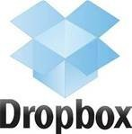




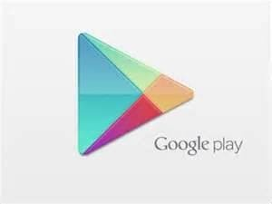

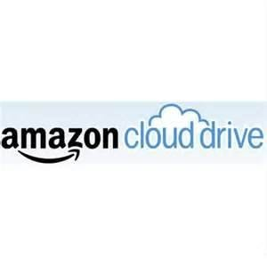








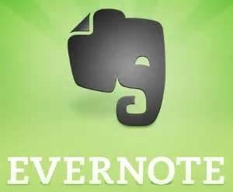


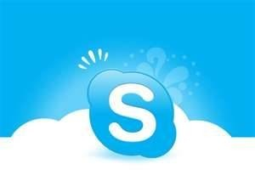

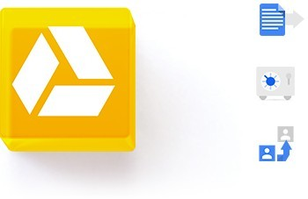

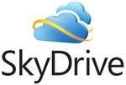
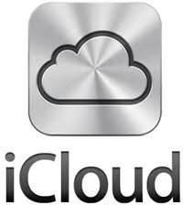
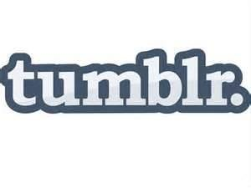








Do you Use the Cloud?

Slide 5
What is Cloud?

Slide 6
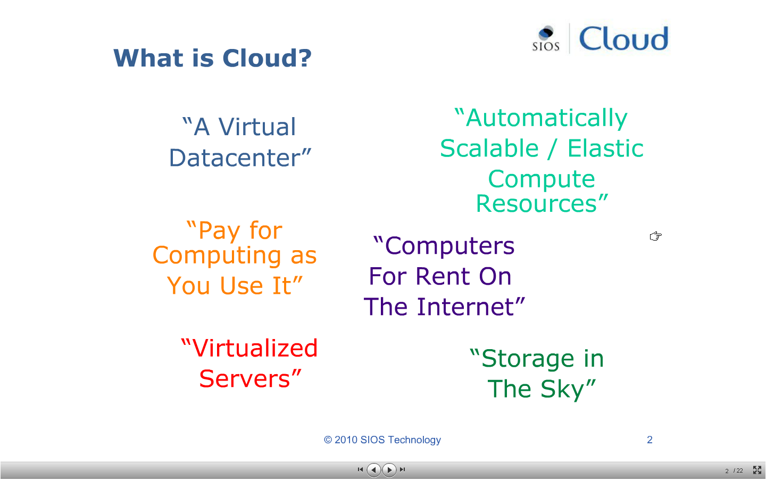
What is Cloud?
Concept evolved in 1950(IBM) called RJE (Remote Job Entry Process)
In 2006 Amazon provided the First public cloud AWS(Amazon Web Services)

Slide 7

What is Cloud?
The term Cloud refers to a Network or Internet. In other words, we can say that Cloud is something, which is present at remote location.
Cloud can provide services over network, i.e., on public networks or on private networks, i.e., WAN, LAN or VPN.
Applications such as e-mail, web conferencing, Customer Relationship Management (CRM), all run in cloud.

Slide 8
What is Cloud Computing?
Distributed computing on internet Or delivery of computing service over the internet
Eg: Yahoo!, GMail, Hotmail
Instead of running an e-mail program on your computer, you log in to a Web e-mail account remotely.
The software and storage for your account doesn't exist on your computer -- it's on the service's computer cloud.
Cloud Computing refers to manipulating, configuring, and accessing applications online.
It offers online data storage, infrastructure and application
Cloud Computing is both a combination of software and hardware based computing resources delivered as a network service
Notes:
In computer networking , cloud computing is a phrase used to describe a variety of computing concepts. Distributed computing on internet.

Slide 9
What is Cloud Computing?
Cloud computing is a technology that uses the internet and central remote servers to maintain data and applications.
A style of computing where massively scalable (and elastic) IT-related capabilities are provided “As A Service” to external customers using Internet technologies.

Slide 10
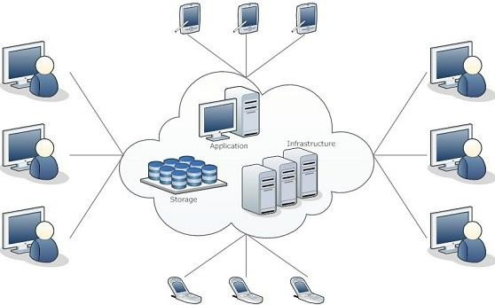
Cloud Computing Architecture

Slide 11
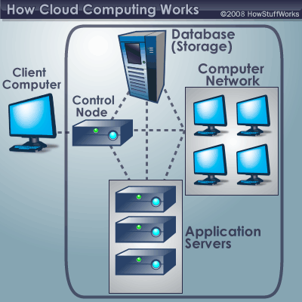
A typical cloud computing system
front end back end.

Slide 12
Cloud Computing - Segments
Cloud computing is broken down into three segments:
  Applications,
  Platforms and
  Infrastructure

Slide 13
Cloud Computing - Segments
1. Applications:
It's all On Demand
  On Demand software services
  Who is Offering On Demand Software?
    International Business Machines (IBM)
    Salesforce.com (CRM)
    EfroTech.com (HRIS)
    Google (GOOG)
    NetSuite (N)
    Cordys
    Taleo (TLEO)
    Concur Technologies (CNQR)
2. Platforms
allow users to access applications from centralized servers using the internet.
Active platforms -
  International Business Machines (IBM) - IBM Cloud - Lotus Live
  Google (GOOG) - Apps Engine
  Amazon.com (AMZN) - EC2
  Microsoft (MSFT) - Windows Azure
  Logicworks (www.logicworks.net) - infiniCloud
  SAVVIS (SVVS) - Symphony VPDC
  Terremark Worldwide (TMRK) - The Enterprise Cloud
  Salesforce.com (CRM) - Force.com
  NetSuite (N) - Suiteflex
  Rackspace Cloud - cloudservers, cloudsites, cloudfiles
  [http://www.metrisoft.com Metrisoft
3. Infrastructure
allow users to build applications
Major Infrastructure Vendors
    Google (GOOG) - Managed hosting, development environment
    International Business Machines (IBM) - Managed hosting
    SAVVIS (SVVS) - Managed hosting & cloud computing
    Terremark Worldwide (TMRK) - Managed hosting
    Amazon.com (AMZN) - Cloud storage
    Rackspace Hosting (RAX) - Managed hosting & cloud computing

Slide 14
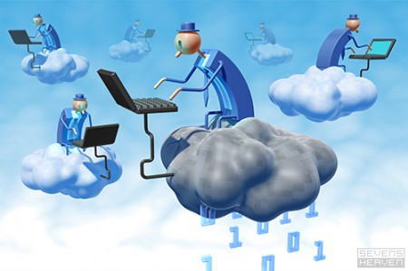
Cloud Computing
Anything that involves delivering hosted services over the Internet.
"X as a Service" or "Anything as a Service " or “Everything as a Service (XaaS)”
  These services are
  IaaS: Infrastructure as a Service
  PaaS: Platform as a Service
  SaaS: Software as a Service
  AaaS: Application as a Service
  HaaS: Hardware as a Service
  MaaS (Management as a Service),
  CaaS (Communications as a Service)
  DaaS (Data or Database or Desktop as a Service).
  “Subscribe & Use -- Pay for what you use, based on QoS”

Slide 15
Basic Concepts
There are certain services and models working behind the scene making the cloud computing feasible and accessible to end users.
Following are the working models for cloud computing:
  Deployment Models
  Service Models

Slide 16
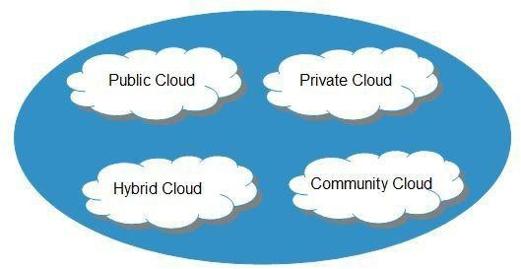
Deployment Models
Deployment models define the type of access to the cloud,
i.e., how the cloud is located?
Cloud can have anyone of the four types of access:
Public, Private, Hybrid and Community

Slide 17
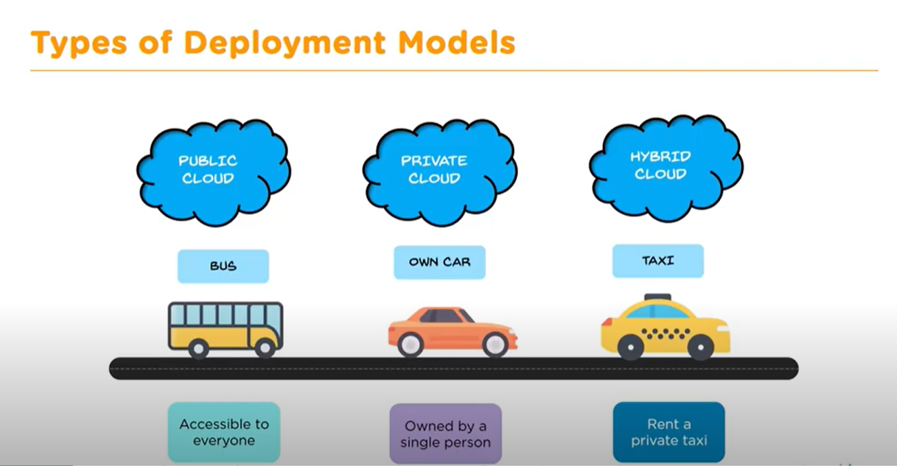
Deployment Models

Slide 18
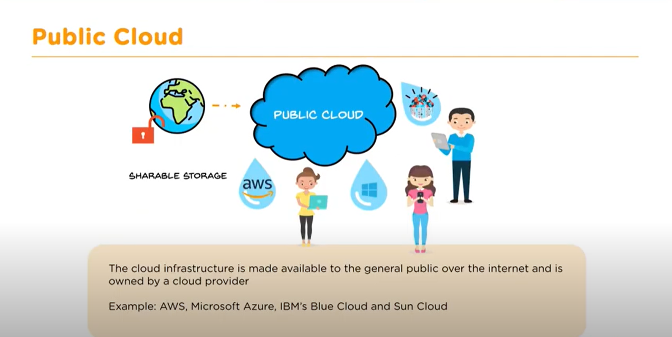
Deployment Models

Slide 19
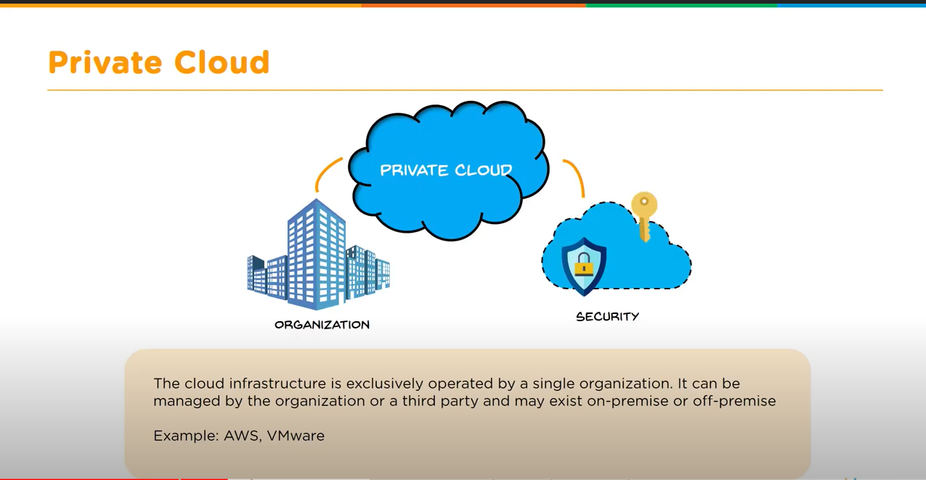
Deployment Models

Slide 20
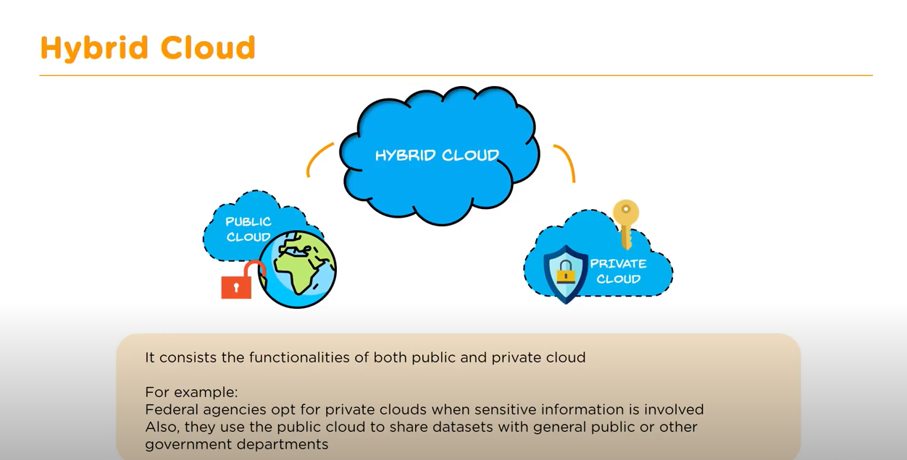
Deployment Models

Slide 21
PUBLIC CLOUD : The Public Cloud allows systems and services to be easily accessible to the general public. Public cloud may be less secure because of its openness, e.g., e-mail
Deployment Models
PRIVATE CLOUD : The Private Cloud allows systems and services to be accessible within an organization. It offers increased security because of its private nature
COMMUNITY CLOUD : The Community Cloud allows systems and services to be accessible by group of organizations
HYBRID CLOUD : The Hybrid Cloud is mixture of public and private cloud. However, the critical activities are performed using private cloud while the non-critical activities are performed using public cloud

Slide 22
Service Models
Service Models are the reference models on which the Cloud Computing is based.
These can be categorized into three basic service models as listed below:
Infrastructure as a Service (IaaS)
Platform as a Service (PaaS)
Software as a Service (SaaS)

Slide 23
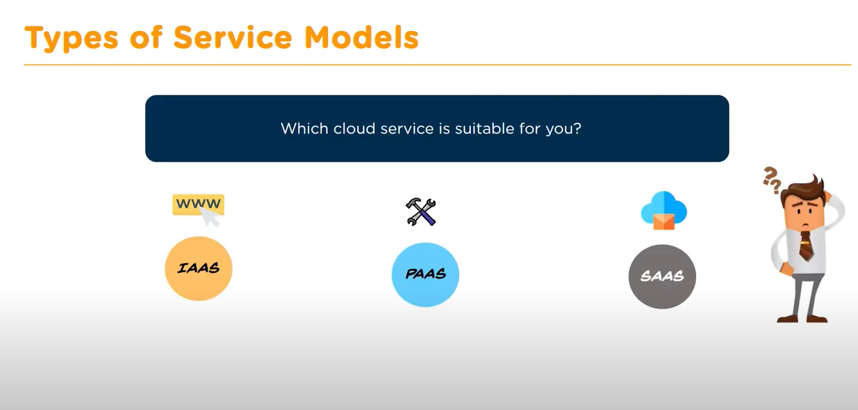
Service Models

Slide 24
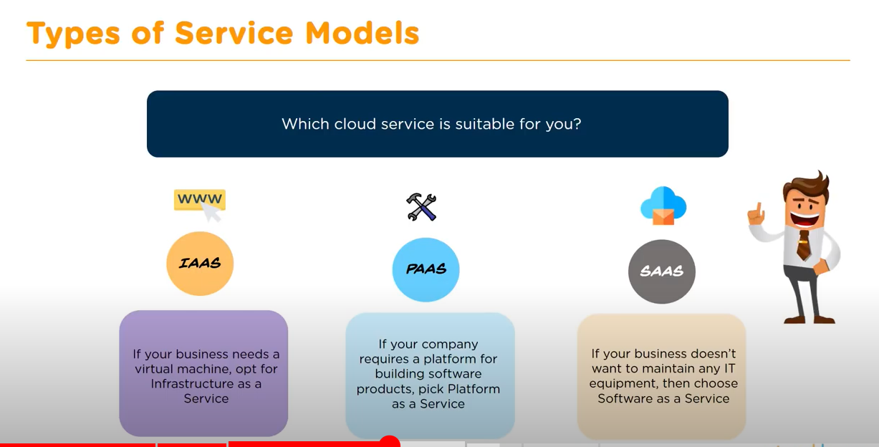
Service Models

Slide 25
Infrastructure as a Service
(IaaS)
IaaS is the delivery of technology infrastructure as an on demand scalable service.
IaaS provides access to fundamental resources such as physical machines, virtual machines, virtual storage, etc.
Usually billed based on usage
Usually multi tenant virtualized environment
Can be coupled with Managed Services for OS and application support

Slide 26
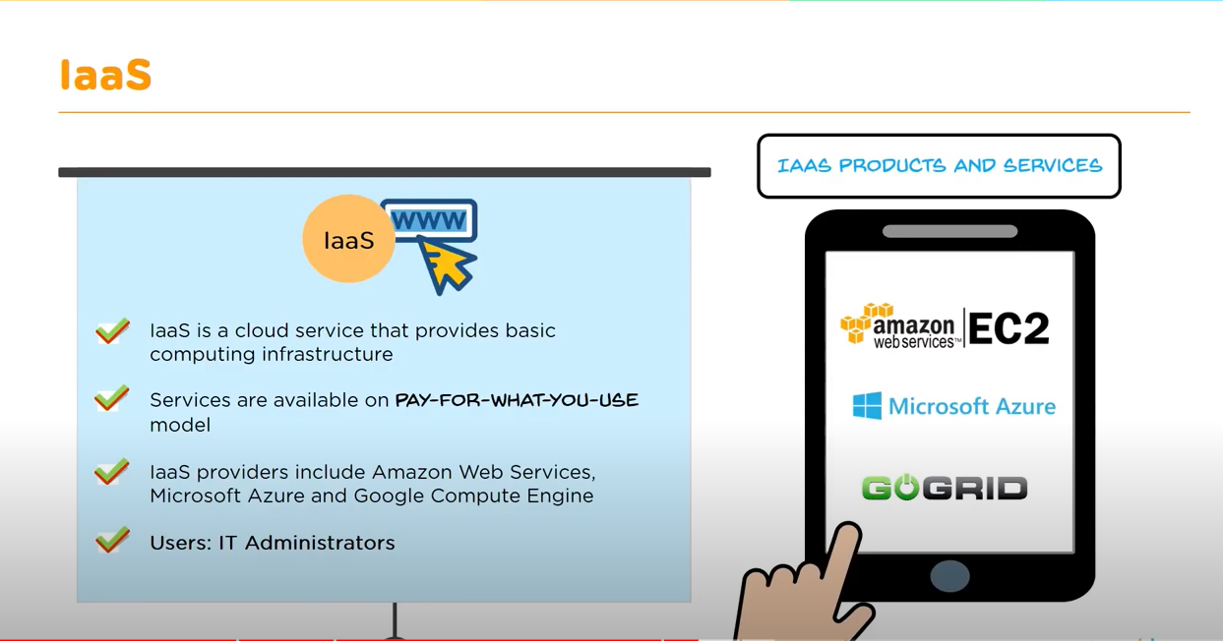
Infrastructure as a Service

Slide 27






Infrastructure as a Service
Examples

Slide 28
Platform as a Service
(PaaS)
PaaS provides the runtime environment for applications, development & deployment tools, etc.
PaaS provides all of the facilities required to support the complete life cycle of building and delivering web applications and services entirely from the Internet.
Typically applications must be developed with a particular platform in mind
Multi tenant environments
Highly scalable multi tier architecture

Slide 29
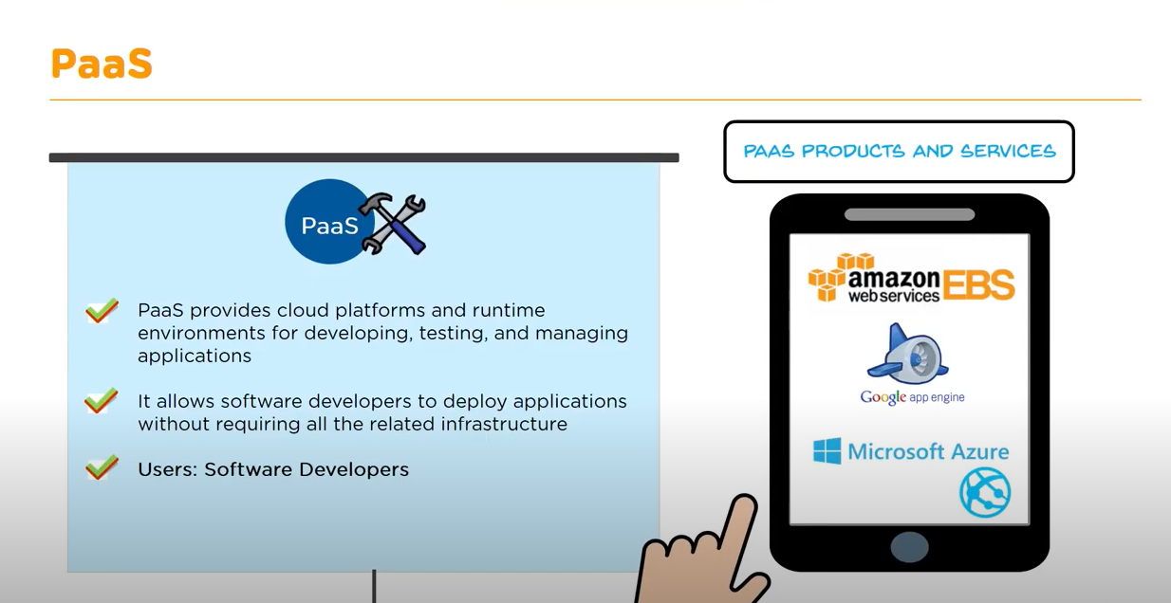
Platform as a Service

Slide 30



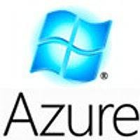


Platform as a Service
Examples

Slide 31
Software as a Service
(SaaS)
SaaS model allows to use software applications as a service to end users.
SaaS is a software delivery methodology that provides licensed multi-tenant access to software and its functions remotely as a Web-based service.
•
•
•
Usually billed based on usage
Usually multi tenant environment
Highly scalable architecture

Slide 32
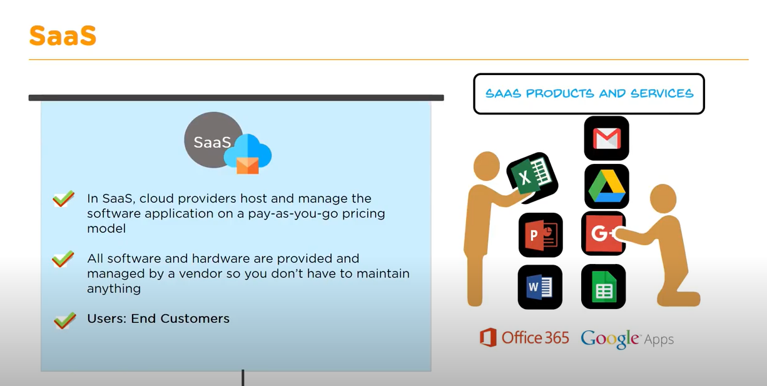
Software as a Service

Slide 33

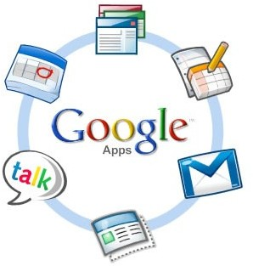

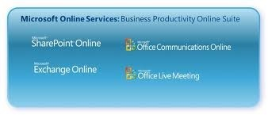

Software as a Service
Examples

Slide 34
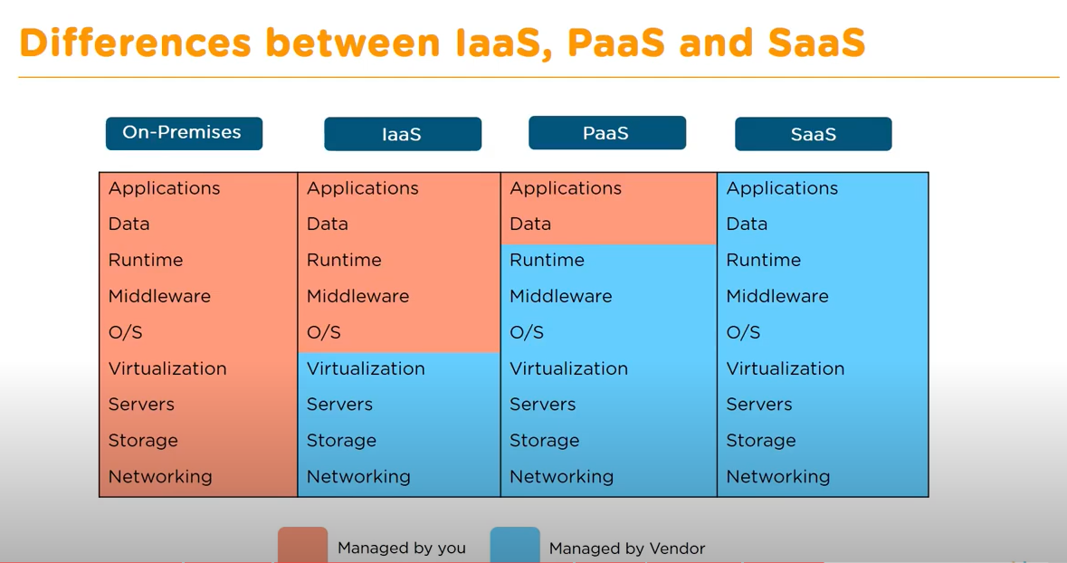
Service Models

Slide 35
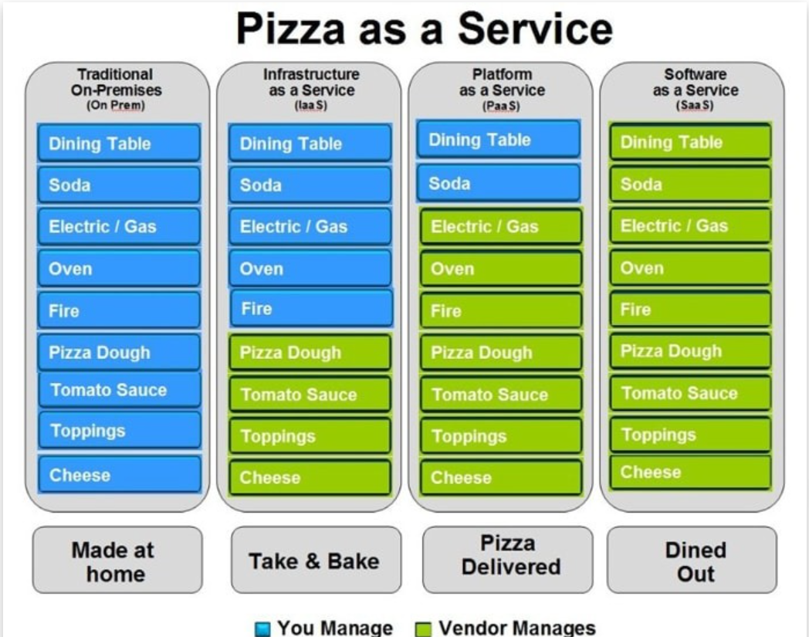

Slide 36
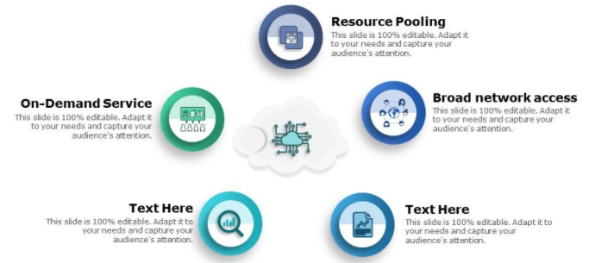
Essential Characteristics
Rapid elasticity
Measured Service

Slide 37
Thank You

